Slide 1

Mechanical
Team: Big Gains B-)
Debby Lin
Ebi Mir-Mohammadsadeghi
Harsh Rajoria

Slide 2
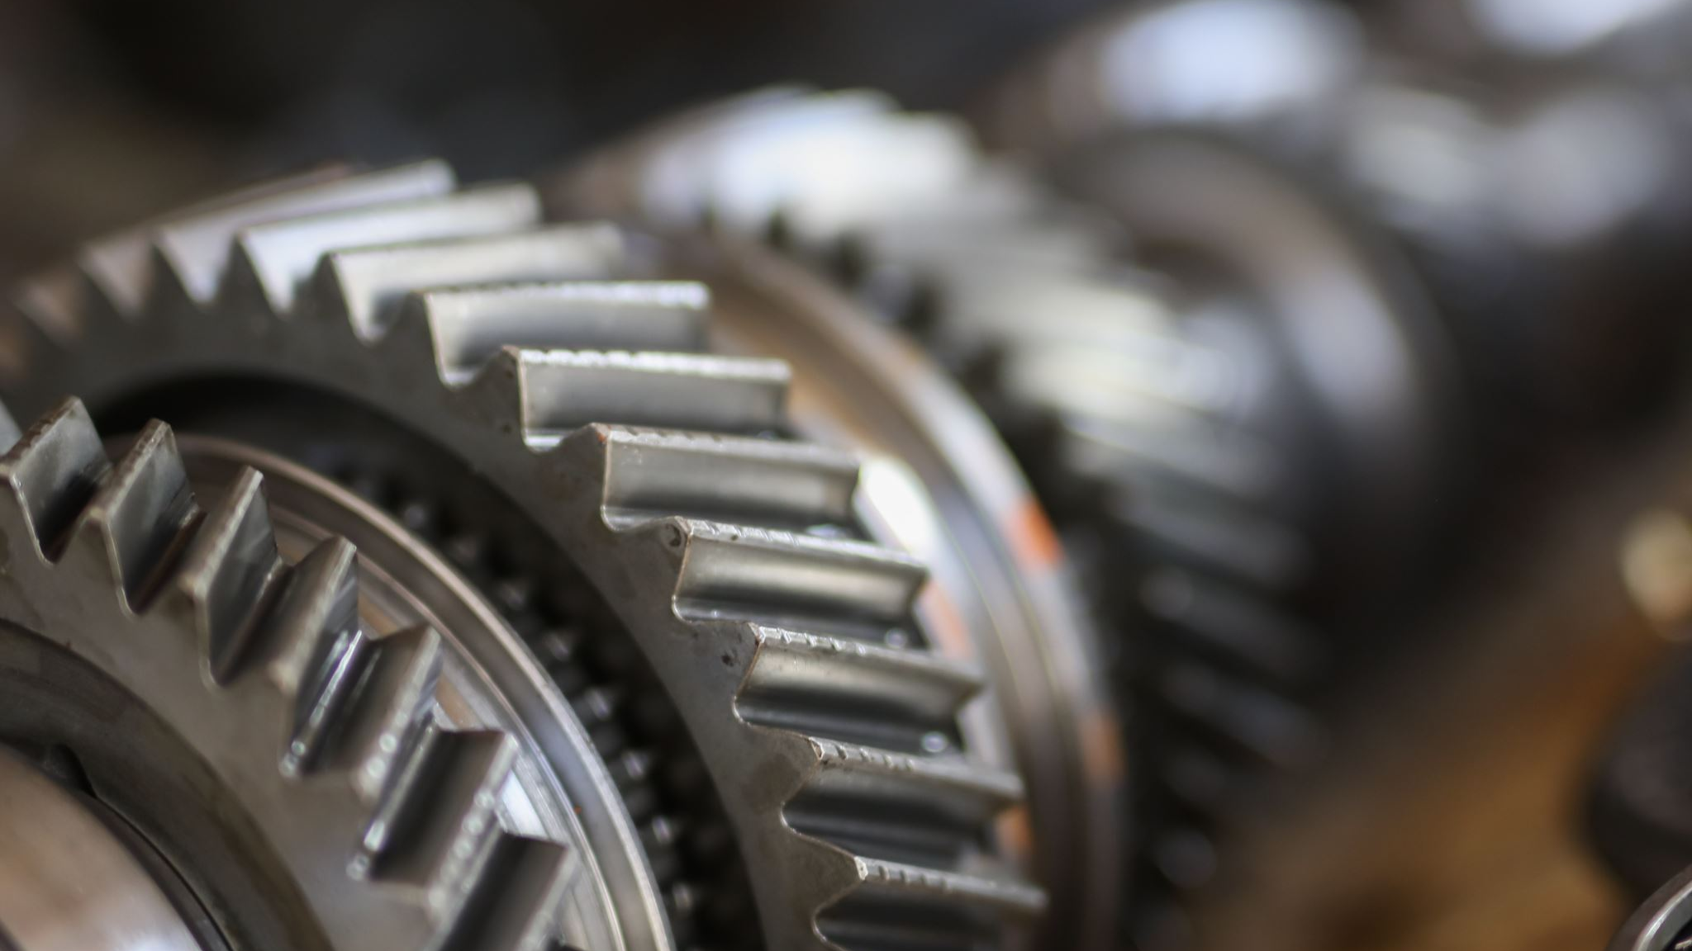
Parts & Assemblies

Slide 3
Gripper Arms & Joints

Slide 4
Linear Approximation and Operating Point

Slide 5
Stress Constraint

Slide 6
Forces & Torques

Slide 7
McMaster Carr Components

Slide 8
SX Model

Slide 9
Circuit Board Housing

Slide 10
Design Driver CCTs???
Idk what this means

Slide 11
Simulate

Slide 12
Develop Linear Models

